Slide 1
Statistics For Data Science
DTSC 620 Fall 2022
Instructor
Kiran Balagani, Ph.D.
kbalagan@nyit.edu
Teaching Assistant
Mr. Pranadeep Potti (mpotti@nyit.edu)

Slide 2
Agenda
Previous Lecture
ROC Analysis
Today’s Lecture
Project Assignment #1 Demo
Base Rate Fallacy
Introduction to Decision Tree Paper/Worksheet

Slide 3
Important Dates and Deadlines
Midterm Exam (Oct. 24th, class time)
Final Exam (December 19th, class time)
Project Assignment 1 (31 October 2022)
Project Assignment 2 (~3rd week of Nov.)
Project Assignment 3 (~2nd week of Dec.)
Additional homework, opinion papers, presentations will be announced

Slide 4
Project Assignment 1 Demo

Slide 5
Previous Lecture

Slide 6
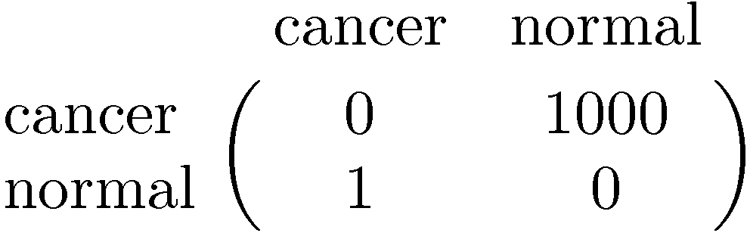
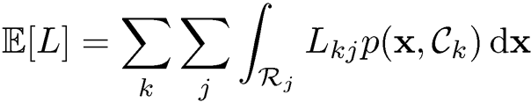
Minimum Expected Loss
Example: classify a medical image as ‘cancer’ or ‘normal’
Decision
Truth

Slide 7
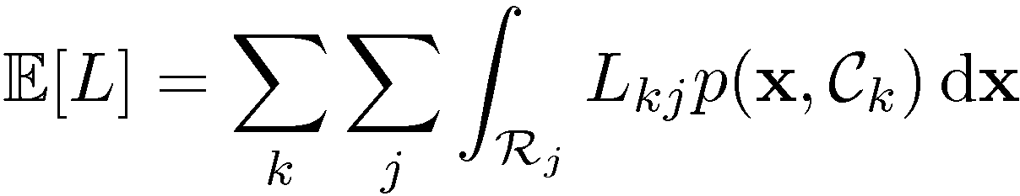

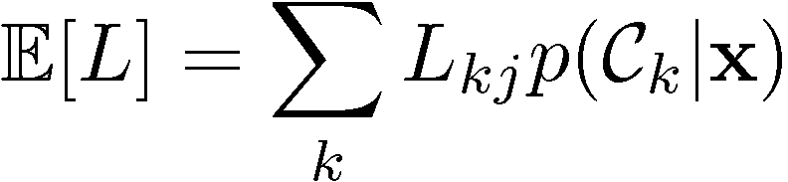
Minimum Expected Loss
Regions are chosen to minimize

Slide 8
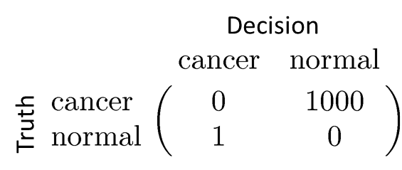

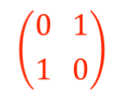
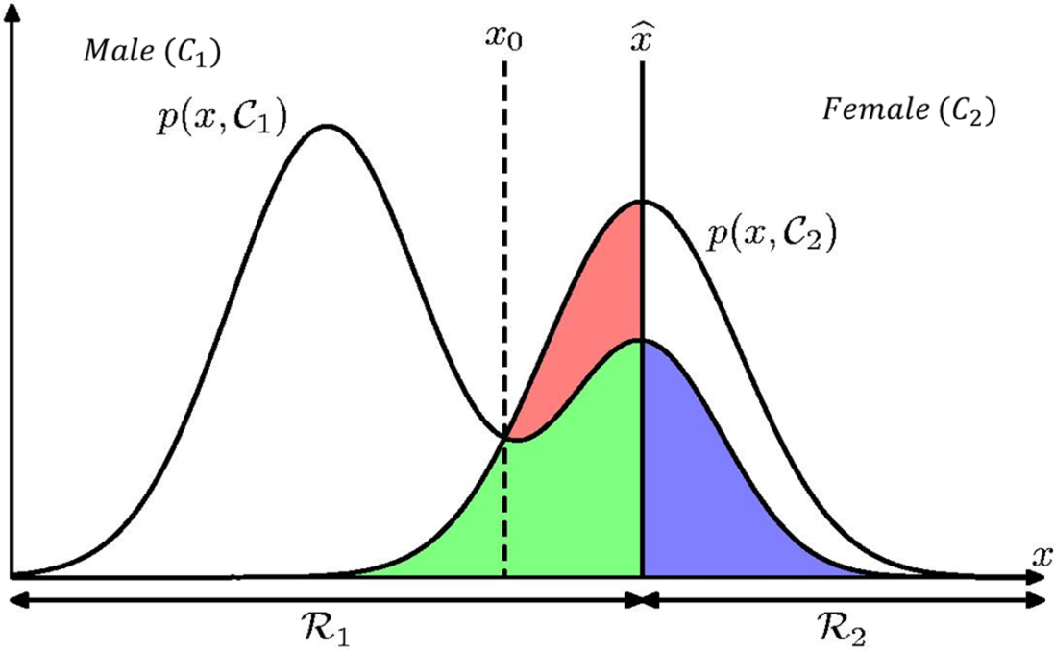



Is Bayes classification rule optimal for 0-1 loss?
1

Slide 9
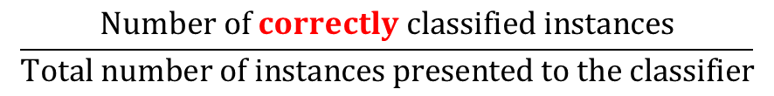
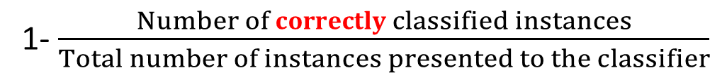
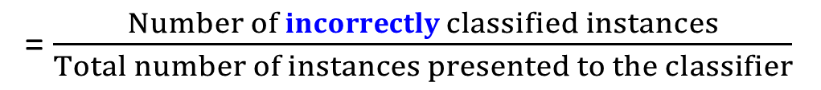
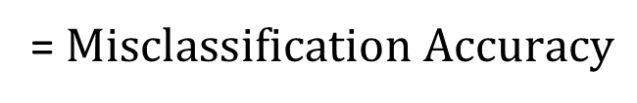
Classification Accuracy

Slide 10
Receiver Operating Characteristic Curve

Slide 11
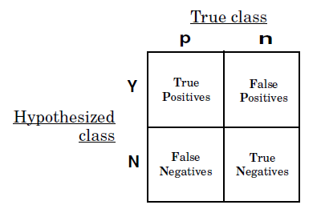

Slide 12
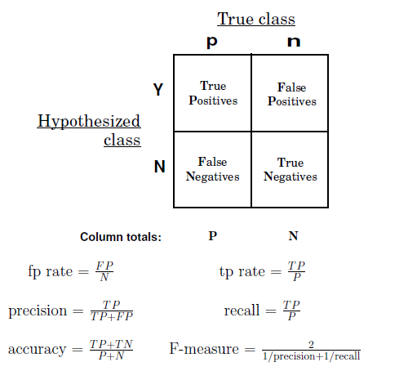

Slide 13
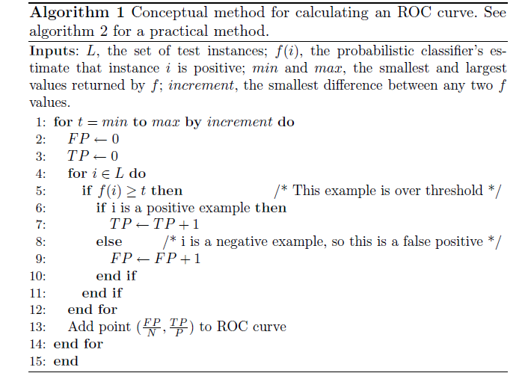
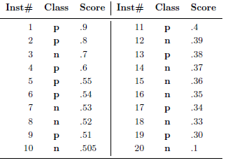

Slide 15
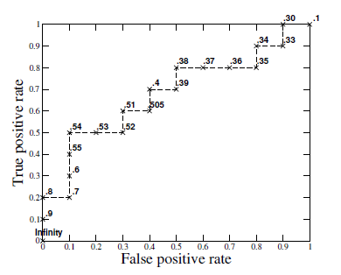

Slide 17
Today’s Lecture

Slide 18
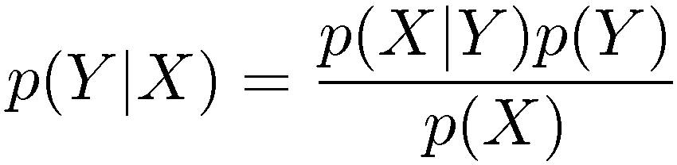
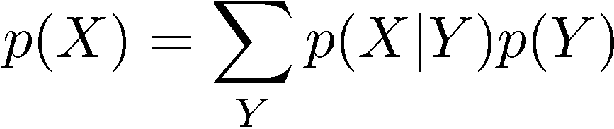
Bayes’ Theorem
posterior ∝ likelihood × prior

Slide 19
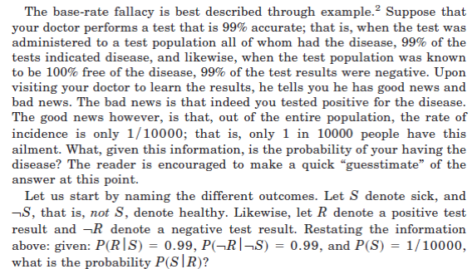

Slide 20


Slide 21
